Slide 1
ANATOMY OF HEART-2
Dr. Muhammad Ameen C
Senior Resident
Dept Of Cardiology
Govt MCH Kozhikode

Slide 2
The heart is a hollow muscular organ – conical shape.
Location-between the lungs in the middle mediastinum, enclosed in the pericardium.

Slide 3
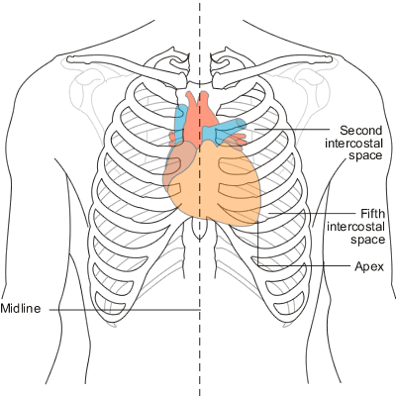
Placed obliquely in the chest behind the body of the sternum and adjoining parts of the rib cartilages.
1/3 on right and 2/3 on left side of midline.

Slide 4
SURFACE ANATOMY
Applies to an average adult.
Considerably modified by age, sex,bodily size and proportions.
Do not correspond to the best sites for auscultation.

Slide 5
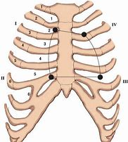
Apex corresponds to apex beat which is in the fifth I.C space slightly medial to mid clavicular line.
Right border-line from upper border of third costal cartilage,1.2 cm from margin of sternum,downwards to sixth costal cartilage.

Slide 6
Lower border- line joining lower end of right border to apex beat.
Left border-line drawn from the apex beat upwards and medially to a point on the lower border of the left second costal cartilage 1.2 cm from sternal margin.

Slide 7
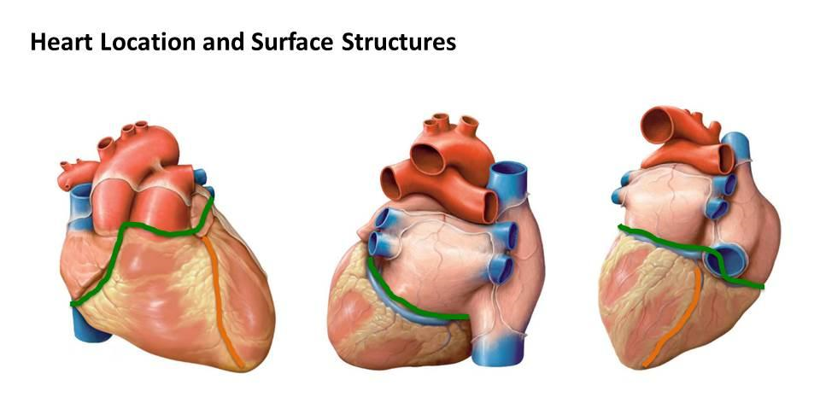
COMPONENT PARTS
Heart-Subdivided by septa into right and left halves, and a constriction subdivides each half of the organ into two cavities, the upper cavity being called the atrium, the lower the ventricle.

Slide 8
CARDIAC GROOVES

Slide 9
The division of the heart into four cavities is indicated on its surface by grooves.
The atria are separated from the ventricles by the coronary sulcus (auriculoventricular groove).
this contains the trunks of the nutrient vessels of the heart, and is deficient in front, where it is crossed by the root of the pulmonary artery.

Slide 10
The interatrial groove, separating the two atria, is scarcely marked on the posterior surface, while anteriorly it is hidden by the pulmonary artery and aorta.
Ventricles separated by two grooves, anterior longitudinal sulcus ( sternocostal surface) , close to its left margin.
the other posterior longitudinal sulcus, on the diaphragmatic surface near the right margin.

Slide 11
These grooves extend from the base of the ventricular portion to a notch, the incisura apicis cordis, on the acute margin of the heart just to the right of the apex.
The external cardiac crux is the cross-shaped intersection between the atrioventricular, posterior interventricular, and interatrial groove.

Slide 13
Its internal counterpart (internal crux) is the posterior intersection between the mitral and tricuspid annuli and the atrial and ventricular septa.
The junction between the anterior and inferior free walls of the right ventricle forms a sharp angle known as the acute margin. The rounded lateral wall of the left ventricle forms the obtuse margin.

Slide 14
STERNOCOSTAL SURFACE
The sternocostal surface is directed forward, upward, and to the left.
Its lower part is convex, formed chiefly by the right ventricle, and traversed near its left margin by the anterior longitudinal sulcus.
Its upper part is separated from the lower by the coronary sulcus, and is formed by the atria; it presents a deep concavity occupied by the ascending aorta and the pulmonary artery

Slide 16
The Apex (apex cordis).—The apex is directed downward, forward, and to the left, and is overlapped by the left lung and pleura
It lies behind the fifth left intercostal space, 8 to 9 cm. from the mid-sternal line, or about 4 cm. below and 2 mm. to the medial side of the left mammary papilla.

Slide 17
STERNOCOSTAL SURFACE

Slide 18
The base (basis cordis) directed upward, backward, and to the right, is separated from the 5th to 8th thoracic vertebræ by the esophagus, aorta, and thoracic duct.
It is formed mainly by the left atrium, and, to a small extent, by the back part of the right atrium.
Quadrilateral in form, it is in relation above with the bifurcation of the pulmonary artery, and is bounded below by the posterior part of the coronary sulcus, containing the coronary sinus.

Slide 19
On the right it is limited by the sulcus terminalis of the right atrium, and on the left by the ligament of the left vena cava and the oblique vein of the left atrium.
The four pulmonary veins, two on either side, open into the LA, while the SVC opens into the upper, and the IVC into the lower, part of the RA.

Slide 20
The diaphragmatic surface directed downward and slightly backward, is formed by the ventricles, and rests upon the central tendon and a small part of the left muscular portion of the diaphragm.
It is separated from the base by the posterior part of the coronary sulcus, and is traversed obliquely by the posterior longitudinal sulcus

Slide 21
RIGHT MARGIN
The right margin of the heart is long, and is formed by the right atrium above and the right ventricle below.
The atrial portion is rounded and almost vertical; it is situated behind the third, fourth, and fifth right costal cartilages about 1.25 cm. from the margin of the sternum.
The ventricular portion, thin and sharp, is named the acute margin; it is nearly horizontal, and extends from the sternal end of the sixth right costal cartilage to the apex of the heart.

Slide 22
LEFT MARGIN
The left or obtuse margin is shorter, full, and rounded: it is formed mainly by the left ventricle, but to a slight extent, above, by the left atrium.
It extends from a point in the second left intercostal space, about 2.5 mm. from the sternal margin, obliquely downward, with a convexity to the left, to the apex of the heart.

Slide 26
EPICARDIUM
The epicardium is the outer layer of the wall of the heart. It is composed of connective tissue covered by epithelium. The epicardium is also known as the visceral pericardium.
Function:
Provides an outer protective layer for the heart

Slide 27
It contains the epicardial coronary arteries and veins, autonomic nerves, lymphatics, and a variable amount of adipose tissue.
The junctions between the visceral and parietal pericardium lie along the great vessels and form the pericardial reflections.

Slide 28
MYOCARDIUM
Myocardium is the muscular middle layer of the wall of the heart. It is composed of spontaneously contracting cardiac muscle fibers which allow the heart to contract.
Function:
Stimulates heart contractions to pump blood from the ventricles and relaxes the heart to allow the artria to receive blood.

Slide 29
HISTOLOGY OF MYOCARDIUM

Slide 30
ENDOCARDIUM
The endocardium is the inner layer of the heart. It consists of epithelial tissue and connective tissue.
Function:
Lines the inner cavities of the heart, covers heart valves and is continuous with the inner lining of blood vessels.
Purkinje fibers are located in the endocardium. They participate in the contraction of the heart muscle.

Slide 31
ventricles

Slide 32
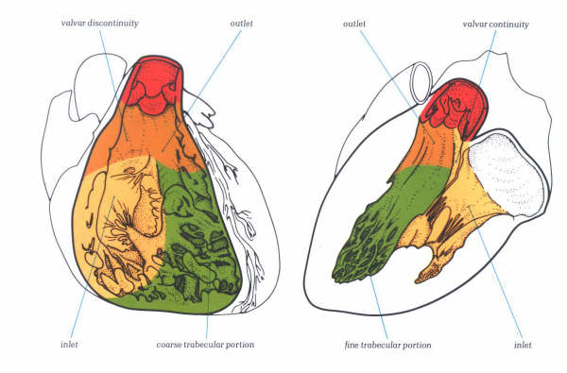
RIGHT VENTRICLE
Right-anterior structure.
Comprised of inlet, trabecular and outflow segments.
Inlet : tricuspid annulus to insertions of the papillary muscles.
Apical trabecular zone extends inferiorly beyond the attachments of the papillary muscles toward the ventricular apex and about halfway along the anterior wall. (site of insertion of CIED leads)
Outflow portion:(conus or infundibulum) : smooth-walled muscular subpulmonary channel.

Slide 33
Crista supraventricularis
Prominent arch-shaped muscular ridge
Separates the tricuspid and pulmonary valves
Made up of three components (parietal band, infundibular septum, and septal band) that can appear as distinct structures or can merge together.

Slide 35
Infundibular septum: Separates RVOT and LVOT
Septal band
Y shaped
Upper limbs cradle infundibular septum
Branching point gives medial tricuspid papillary muscle
Moderator band:intracavitary muscle that connects the septal band with the anterior tricuspid papillary muscle.

Slide 37
Annular attachment of septal leaflet of TV is more apical than that of AML
Exceptions(same level)
Partial AV septal defects
Double inlet ventricle
Exaggeration of apical displacement: Ebstein anomaly

Slide 39
During right ventricular endomyocardial biopsy, tissue generally is obtained from the septum
Disruption of a portion of the tricuspid support apparatus is a potential complication of right-sided heart instrumentation (e.g., right ventricular endomyocardial biopsy).

Slide 40
LEFT VENTRICLE
Made of an inlet portion (MV apparatus), a subaortic outflow portion, and a finely trabeculated apical zone.
LV free wall is thickest toward the base and thinnest toward the apex

Slide 41
Structurally, the left and right ventricles differ considerably.
LV free-wall and septal thicknesses are three times the thickness of the RV free wall.
MV and AV share fibrous continuity, whereas the parietal band separates the TV and PV

Slide 42
MV has an elliptical orifice and no septal attachments, TV has a triangular orifice and numerous direct septal attachments .
RV apex is much more trabeculated than LV apex.
The distinctive differences in apical trabeculations persist even in markedly hypertrophied or dilated hearts.

Slide 44
Because of the rightward bulging of the ventricular septum, the LV chamber appears circular in cross section, whereas the RV chamber has a crescentic appearance.
LV false tendons( pseudo-tendons) or bands, are that

Slide 45
Lv false tendons/bands
Discrete, thin, cordlike fibromuscular structures
Occur in 50% of hearts, M>F
Not attached to the mitral leaflets
Connect 2 walls, 2 papillary muscles, or a papillary muscle to a wall, usually the ventricular septum
Can calcify with age
Can cause innocent systolic murmur and arrhythmogenic circuit
Can be confused with ruptured chords, mural thrombi, or vegetations

Slide 46
Most common location

Slide 47
lvnc
“Spongy myocardium”
Due to arrest in in-utero process of myocardial compaction
Persistence of prominent ventricular trabeculations and deep intertrabecular recesses

Slide 48
INTERVENTRICULAR SEPTUM
IVS is a complex partition.
4 parts: (1) inlet, (2) trabecular, (3) membranous, and (4) infundibular.
The plane of the infundibular portion is different from that of the 3 other portions.
This anatomic relationship is important in many forms of CHD in which the infundibular septum is dissociated from the remainder of the ventricular septum (e.g., malalignment forms of VSD in TOF and DORV.)

Slide 54
IVS also can be divided into muscular and membranous portions.
The membranous septum lies beneath the right and posterior (noncoronary) aortic cusps and contacts the mitral and tricuspid annuli.
The majority of clinically significant ventricular septal defects involve the membranous septum
The basal half of the ventricular septum is smooth-walled, whereas the apical half is characterized by numerous small and irregularly arranged trabeculations.

Slide 55
Age related IVS angulation can mimic HCM
Especially with the use of diuretics and afterload reducing agents

Slide 56
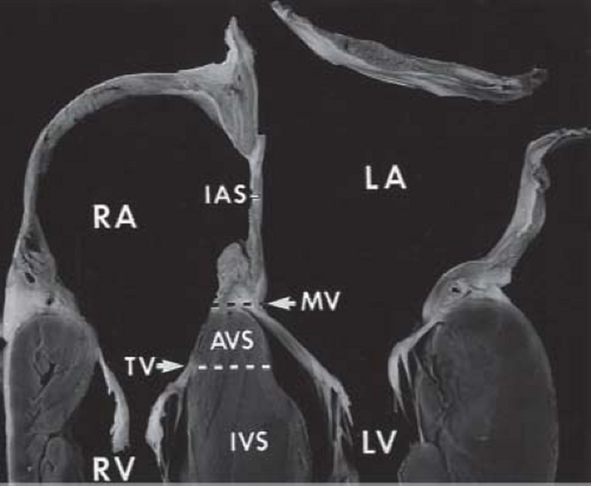
ATRIAL SEPTUM
When viewed from its right aspect, the atrial septum is composed of interatrial and atrioventricular regions.
The interatrial portion is characterized by the fossa ovalis, which is the anatomic hallmark of a morphologic right atrium .
Its outer muscular rim is a horseshoeshaped limbus, and its central depression is the valve of the fossa ovalis.

Slide 57
ATRIAL SEPTUM
When viewed from its right aspect, the atrial septum is composed of interatrial and atrioventricular regions.
The interatrial portion is characterized by the fossa ovalis, which is the anatomic hallmark of a morphologic right atrium .
Its outer muscular rim is a horseshoeshaped limbus, and its central depression is the valve of the fossa ovalis.

Slide 58
FORAMEN OVALE

Slide 61
The potential interatrial passageway between the limbus and the valve : Foramen of ovale
In one-third population FO remains patent
When viewed from the LA, the atrial septum is entirely interatrial because the atrioventricular component lies below the mitral annulus
Limbus of the fossa ovalis is completely covered by its opaque valve and is not directly visible from LA

Slide 64
The atrioventricular (AV) portion of the atrial septum is made of major muscular and minor membranous components and separates the right atrium from the left ventricle.
This explains why there is a potential for left-ventricularto-right-atrial shunts.
The AV septum corresponds roughly to the triangle of Koch (see an important anatomic surgical landmark because it contains the AV node and proximal portion of the AV (His) bundle.

Slide 65
Thus, during tricuspid annuloplasty procedures and patch closures of membranous ventricular septal defects, care must be taken to avoid injury to the conduction system.
The muscular component of the AV septum is interposed between the membranous septum anteriorly and the internal cardiac crux posteriorly

Slide 66
A prominent internal muscle ridge, the crista terminalis, separates the right atrial free wall into a smooth-walled posterior region that receives the venae cavae and coronary sinus and a muscular anterior region that is lined by parallel pectinate muscles and from which the right atrial appendage emanates. (Pectinatus = comb)
pectinate muscles and crista terminalis resemble the teeth and backbone of a comb, respectively.
The right atrial appendage abuts the right aortic sinus and overlies the proximal right coronary artery.

Slide 69
The atrial lead of a dual-chamber pacemaker is normally positioned within the trabeculations of the right atrial appendage.
The right atrial free wall is paper-thin between pectinate muscles and therefore can be perforated easily by stiff catheters.

Slide 70
Thus transseptal cardiac catheterization is more easily accomplished via the IVC, whereas instrumentation of the right ventricular apex (e.g., placement of an ICD or ventricular pacemaker lead) is more easily accomplished via the SVC.
Inferior vena caval blood flow is directed by the eustachian valve toward the foramen ovale, and superior vena caval blood is directed toward the tricuspid valve.

Slide 71
LEFT ATRIUM
The pulmonary vein orifices lie on the posterolateral (left pulmonary veins) and posteromedial (right pulmonary veins) aspects of the left atrial cavity.
The left and right upper pulmonary veins are directed anterosuperiorly, whereas the lower veins enter the left atrium nearly perpendicular to the posterior atrial wall1
. Left atrial muscle extends some distance within the pulmonary veins. The resultant cuff of muscle acts as a sphincter during atrial systole and can be the source of focal atrial fibrillation that is amenable to catheter ablation.

Slide 72
LEFT ATRIUM

Slide 73
The atrial appendage arises anterolaterally and lies in the left atrioventricular groove atop the proximal portion of the left circumflex coronary artery and, in some individuals, the left main coronary artery.
The left atrial appendage is smaller, more tortuous, and less pyramidal than its right atrial counterpart.
At least 80 percent are multilobed (up to four lobes, but the most frequent finding is two lobes)

Slide 74
In contrast to the right atrial free wall, the left has no crista terminalis and no pectinate muscles outside its appendage.
A thorough appreciation of the variations in normal left atrial appendage morphology has become important because a thrombus can be missed if all lobes in the appendage are not visualized.

Slide 76
CARDIAC CONDUCTION SYSTEM
Consists of the SA node, internodal tracts, AV node, AV (His) bundle, and right and left bundle branches.
SA node is located subepicardially in the terminal groove, close to the junction between the superior vena cava and right atrium.
The sinus node artery arises from the right coronary artery in 55 % of people.

Slide 77
CONDUCTION SYSTEM OF HEART

Slide 78
By light microscopy, there are no morphologically distinct conduction pathways between the sinus and AV nodes.
However, electrophysiologic studies support the concept of functional preferential pathways that travel along the crista terminalis and atrial septum including the limbus but not the valve of the fossa ovalis.

Slide 79
Internodal conduction disturbances therefore are not expected as a result of transseptal procedures.
With the Mustard operation for complete TGA, there can be severe disturbance of internodal conduction because the entire septum is resected, and the surgical atriotomy can disrupt the crista terminalis.
Ventricular preexcitation is most commonly associated with aberrant bypass tracts that span the annulus of the tricuspid or mitral valve .

Slide 80
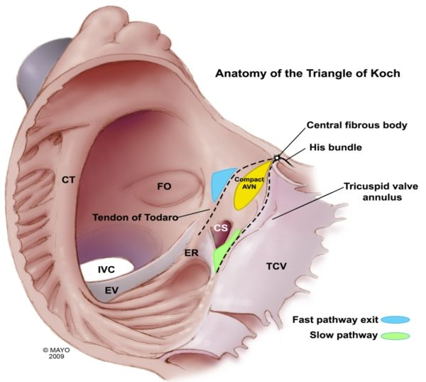
The AV node, in contrast to the sinus node, is a subendocardial structure that is located within the triangle of Koch.
The triangle of Koch is bordered by the coronary sinus ostium posteroinferiorly and the septal tricuspid annulus anteriorly.
Because of its right atrial location near the tricuspid annulus, the AV node is susceptible to injury during tricuspid annuloplasty and during plication procedures for Ebstein's anomaly.

Slide 81
The AV (His) bundle arises from the distal portion of the AV node and travels along the ventricular septum adjacent to the membranous septum .
The AV conduction tissue is generally remote from the defect in the outlet, inlet, and muscular forms of ventricular septal defect but travels along the inferior margin of a membranous ventricular septal defect.
The AV bundle travels through the central fibrous body (right fibrous trigone) and therefore is closely related to the annuli of the aortic, mitral, and tricuspid valves.

Slide 82
The right bundle branch emanates from the distal portion of the AV bundle and forms a cord-like structure that travels along the septal and moderator bands toward the anterior tricuspid papillary muscle .
In contrast, the left bundle branch represents a broad fenestrated sheet of subendocardial conduction fibers that spread along the septal surface of the left ventricle.

Slide 83
Left ventricular pseudo-tendons can contain conduction tissue from the left bundle branch.
The LBB can be disrupted following surgical myectomy, whereas the RBB can be damaged during percutaneous alcohol septal ablation.
Following right ventriculotomy for reconstruction of the RVOT, the ECG shows a pattern of RBBB even though the right bundle is not disrupted.

Slide 84
Thank You

